Slide 1
Remote Physiotherapy and Monitoring system

Slide 2
Project team members
Bavyesh Mattoo
Bed Prasad Aryal
Bhagyashri B

Slide 3
Problem statement
Frequent visit to hospitals travelling problems
People from remote areas who are usually engaged in field/farm works cannot visit when required
Sometimes after going to hospital doctors mayor may not be available
Standing in a long queue for doctor appointment

Slide 4
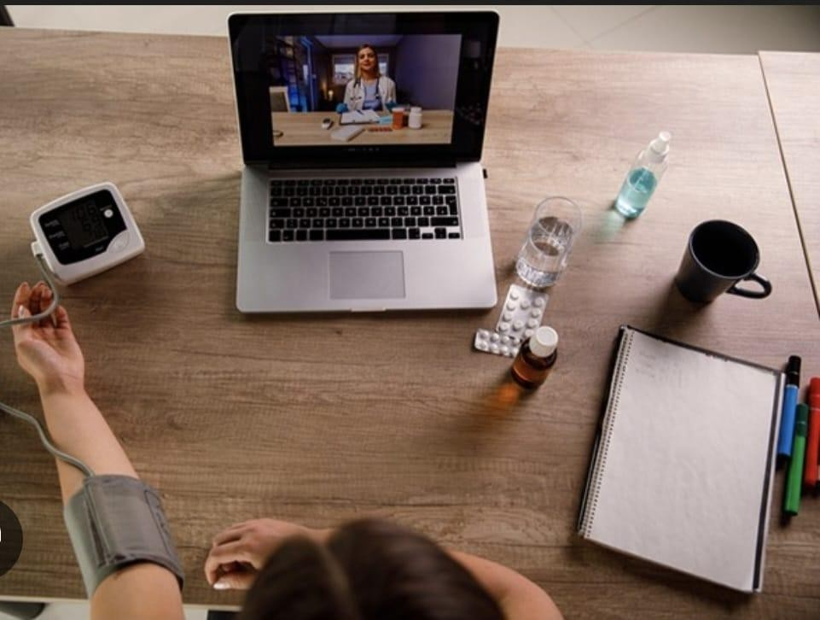
Objective
Reduces travelling cost
People from remote areas can easily contact doctors
Patients can excess the consultated doctor schedule
Doctors can easily access the progress report of the patient of post-surgery.

Slide 5
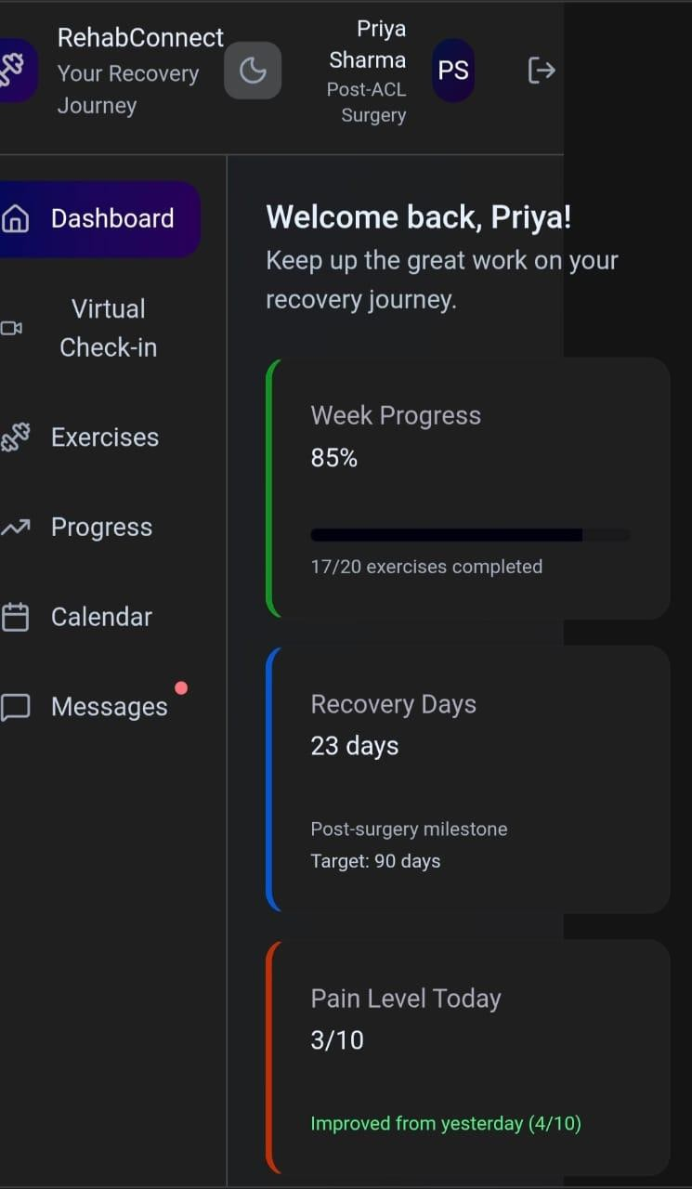
Project progress report
Track weekly exercise progress
Monitor overall recovery timeline
Log and pain review levels
Using "calendar" we track appointments , exercise schedules and remainders
Communicate easily with your therapist

Slide 6





conclusions
Guidelines
Establishment
Setting time to communicate with doctors
Tablet
prescription
Remote physiological monitoring
Patient data
analysis
Instruction and
advise

Slide 7
Website link
https://naming-guitar-90229212.figma.site

Slide 8
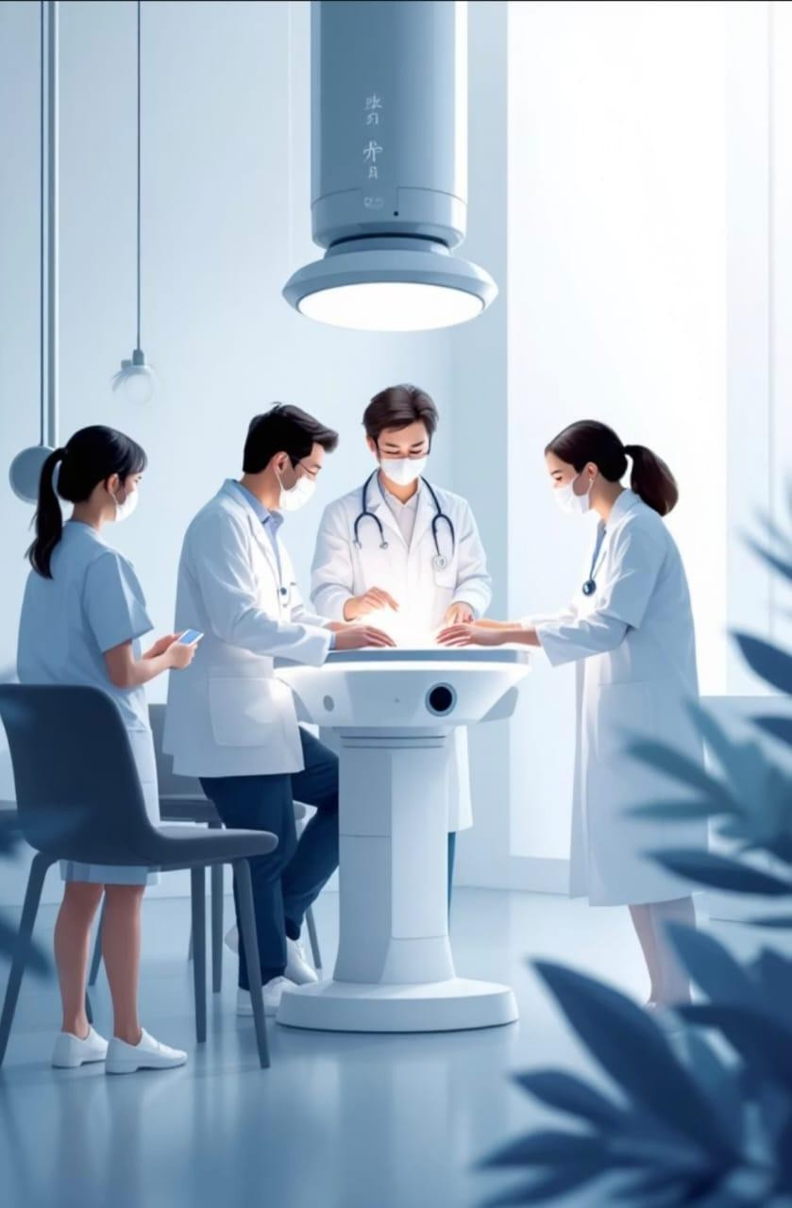
Thank you

